Slide 1
Genetic algorithm
Terminologies

Slide 2
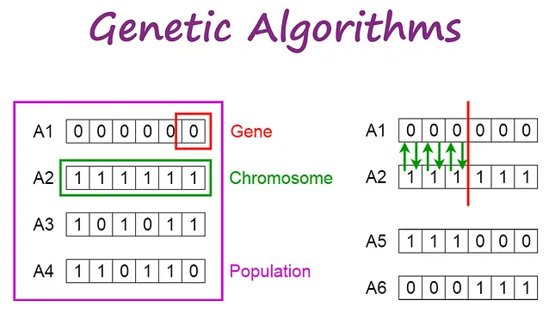
introduction
A genetic algorithm
is a search heuristic that is inspired by Charles Darwin’s theory of natural evolution.
This algorithm reflects the process of natural selection where the fittest individuals are selected for reproduction in order to produce offspring of the next generation.

Slide 3
Notion of Natural Selection
The process of natural selection starts with the selection of fittest individuals from a population.
They produce offspring which inherit the characteristics of the parents and will be added to the next generation.
If parents have better fitness, their offspring will be better than parents and have a better chance at surviving.
This process keeps on iterating and at the end, a generation with the fittest individuals will be found.
This notion can be applied for a search problem.
We consider a set of solutions for a problem and select the set of best ones out of them.
Five phases are considered in a genetic algorithm.
Initial population
Fitness function
Selection
Crossover
Mutation

Slide 4
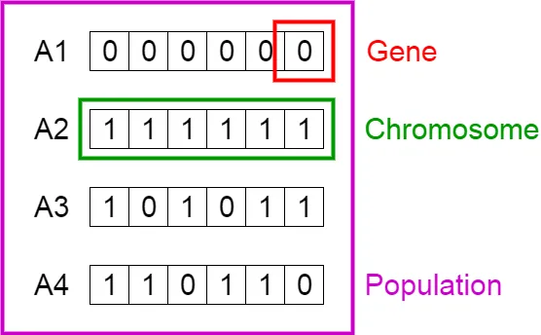
Initial Population
The process begins with a set of individuals which is called a Population. Each individual is a solution to the problem you want to solve.
An individual is characterized by a set of parameters (variables) known as Genes. Genes are joined into a string to form a Chromosome (solution).
In a genetic algorithm, the set of genes of an individual is represented using a string, in terms of an alphabet.
Usually, binary values are used (string of 1s and 0s). We say that we encode the genes in a chromosome.

Slide 5
Fitness Function
The fitness function determines how fit an individual is (the ability of an individual to compete with other individuals).
It gives a fitness score to each individual.
The probability that an individual will be selected for reproduction is based on its fitness score.

Slide 6
Selection
The idea of selection phase is to select the fittest individuals and let them pass their genes to the next generation.
Two pairs of individuals (parents) are selected based on their fitness scores. Individuals with high fitness have more chance to be selected for reproduction.

Slide 7
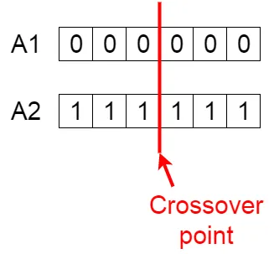
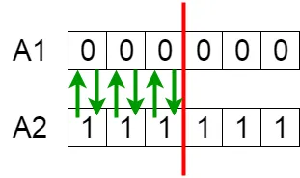
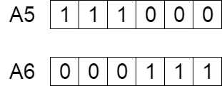
Crossover
Crossover is the most significant phase in a genetic algorithm. For each pair of parents to be mated, a crossover point is chosen at random from within the genes.
For example, consider the crossover point to be 3 as shown below.
Offspring are created by exchanging the genes of parents among themselves until the crossover point is reached.

Slide 8
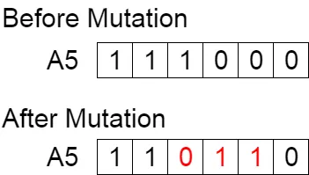
mutation
In certain new offspring formed, some of their genes can be subjected to a mutation with a low random probability.
This implies that some of the bits in the bit string can be flipped.
Mutation occurs to maintain diversity within the population and prevent premature convergence.

Slide 9
Termination
The algorithm terminates if the population has converged (does not produce offspring which are significantly different from the previous generation).
Then it is said that the genetic algorithm has provided a set of solutions to our problem.

Slide 10
Comments
The population has a fixed size.
As new generations are formed, individuals with least fitness die, providing space for new offspring.
The sequence of phases is repeated to produce individuals in each new generation which are better than the previous generation.

Slide 11
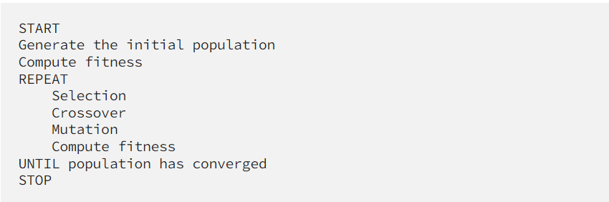
Pseudocode

Slide 12
Crossover types

Slide 13
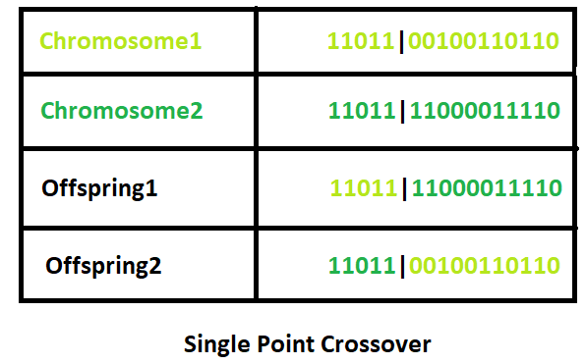
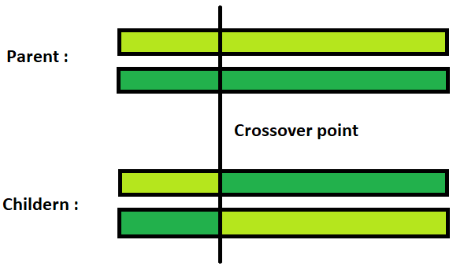
Single Point Crossover:
A crossover point on the parent organism string is selected.
All data beyond that point in the organism string is swapped between the two parent organisms.

Slide 14
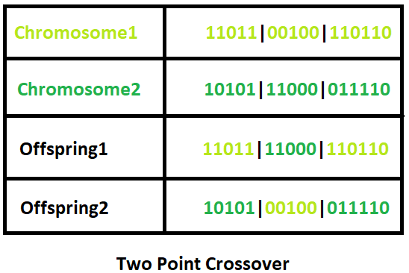
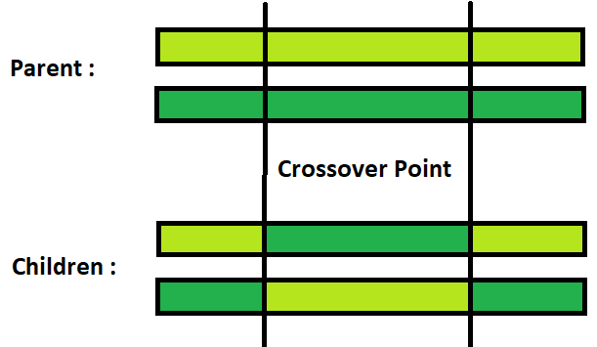
Two-Point Crossover
This is a specific case of a N-point Crossover technique. Two random points are chosen on the individual chromosomes (strings) and the genetic material is exchanged at these points.

Slide 15
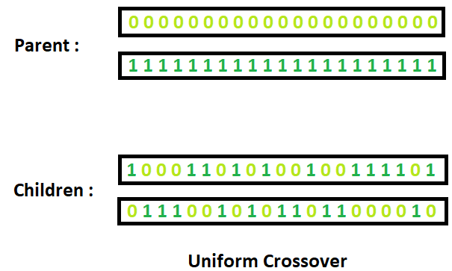
Uniform Crossover
Each gene (bit) is selected randomly from one of the corresponding genes of the parent chromosomes.
Use tossing of a coin as an example technique.

Slide 16
Example problem and solution using Genetic Algorithms

Slide 17
task
Given a target string, the goal is to produce target string starting from a random string of the same length. In the following implementation, following analogies are made
Characters A-Z, a-z, 0-9, and other special symbols are considered as genes
A string generated by these characters is considered as chromosome/solution/Individual
Fitness score is the number of characters which differ from characters in target string at a particular index. So individual having lower fitness value is given more preference.

